Slide 1
Ensemble Techniques
Dr. Mehmet Yasin Ulukuş

Slide 2
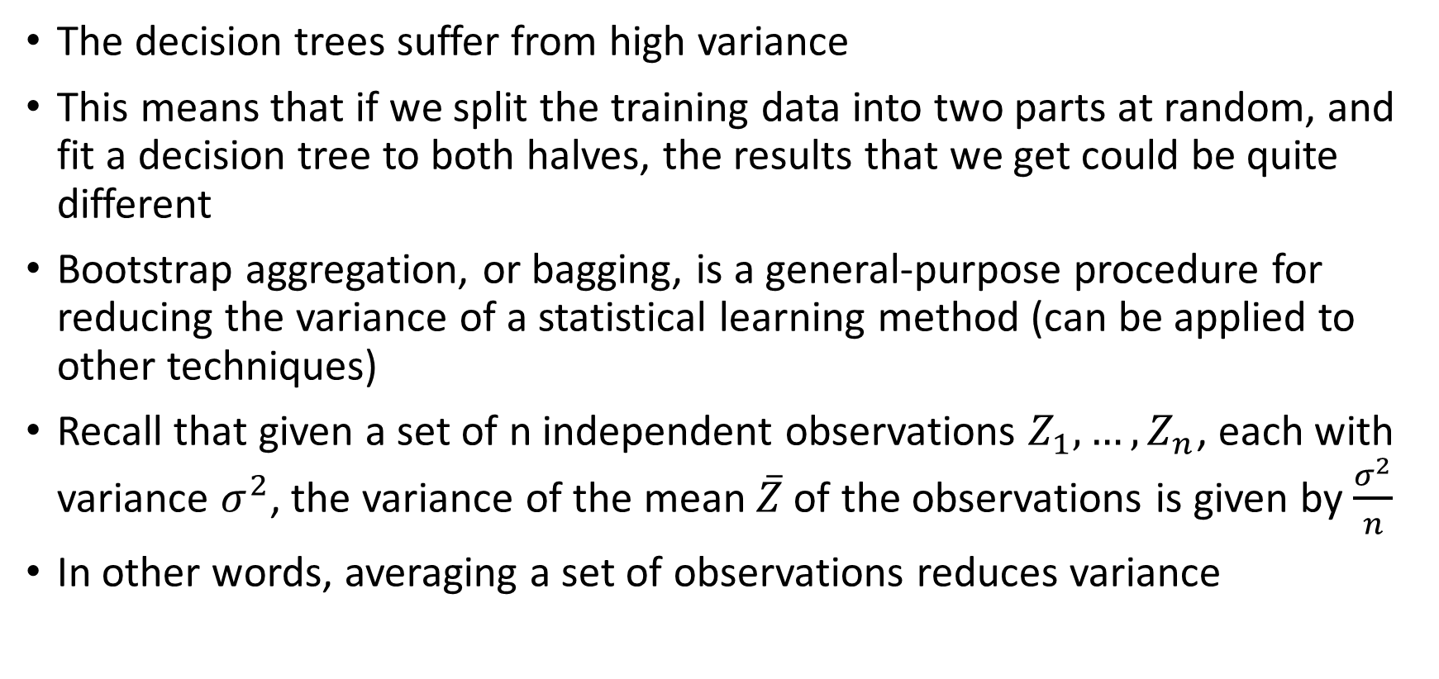
Bagging
The decision trees suffer from high variance
This means that if we split the training data into two parts at random, and fit a decision tree to both halves, the results that we get could be quite different
Bootstrap aggregation, or bagging, is a general-purpose procedure for reducing the variance of a statistical learning method (can be applied to other techniques)
Recall that given a set of n independent observations $Z_{1},…,Z_{n}$, each with variance $σ^{2}$, the variance of the mean $\overline{Z}$of the observations is given by $\frac{σ^{2}}{n}$
In other words, averaging a set of observations reduces variance

Slide 3
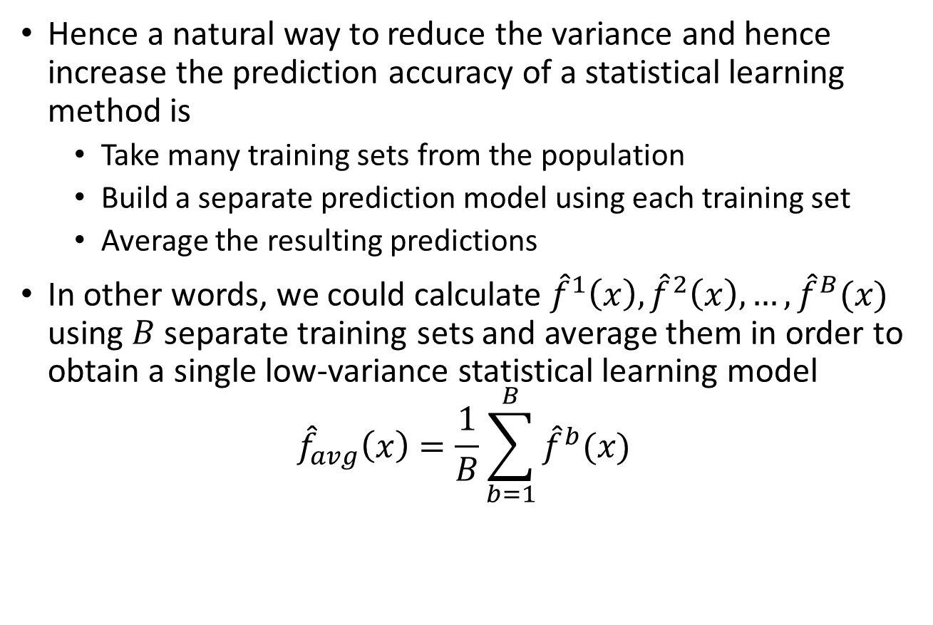
Bagging
Hence a natural way to reduce the variance and hence increase the prediction accuracy of a statistical learning method is
Take many training sets from the population
Build a separate prediction model using each training set
Average the resulting predictions
In other words, we could calculate ${\hat{f}}^{1}\left(x\right),{\hat{f}}^{2}\left(x\right),…,{\hat{f}}^{B}(x)$ using $B$ separate training sets and average them in order to obtain a single low-variance statistical learning model
$${\hat{f}}_{avg}\left(x\right)=\frac{1}{B}\sum_{b=1}^{B}{{\hat{f}}^{b}(x)}$$

Slide 4
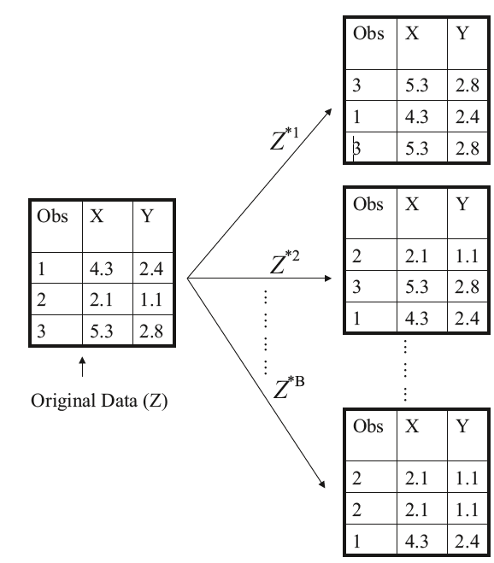
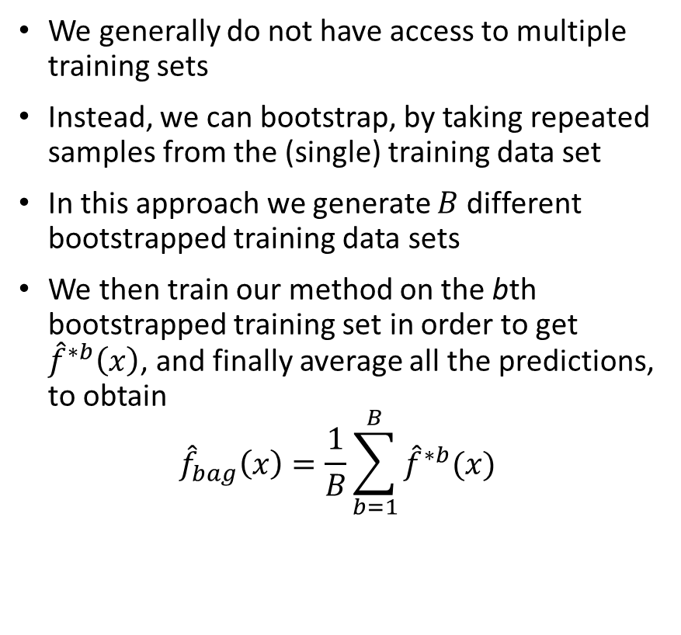
Bagging
We generally do not have access to multiple training sets
Instead, we can bootstrap, by taking repeated samples from the (single) training data set
In this approach we generate $B$ different bootstrapped training data sets
We then train our method on the bth bootstrapped training set in order to get ${\hat{f}}^{∗b}\left(x\right)$, and finally average all the predictions, to obtain
$${\hat{f}}_{bag}\left(x\right)=\frac{1}{B}\sum_{b=1}^{B}{{\hat{f}}^{∗b}(x)}$$
A graphical illustration of the bootstrap approach on a small
sample containing n = 3 observations

Slide 5
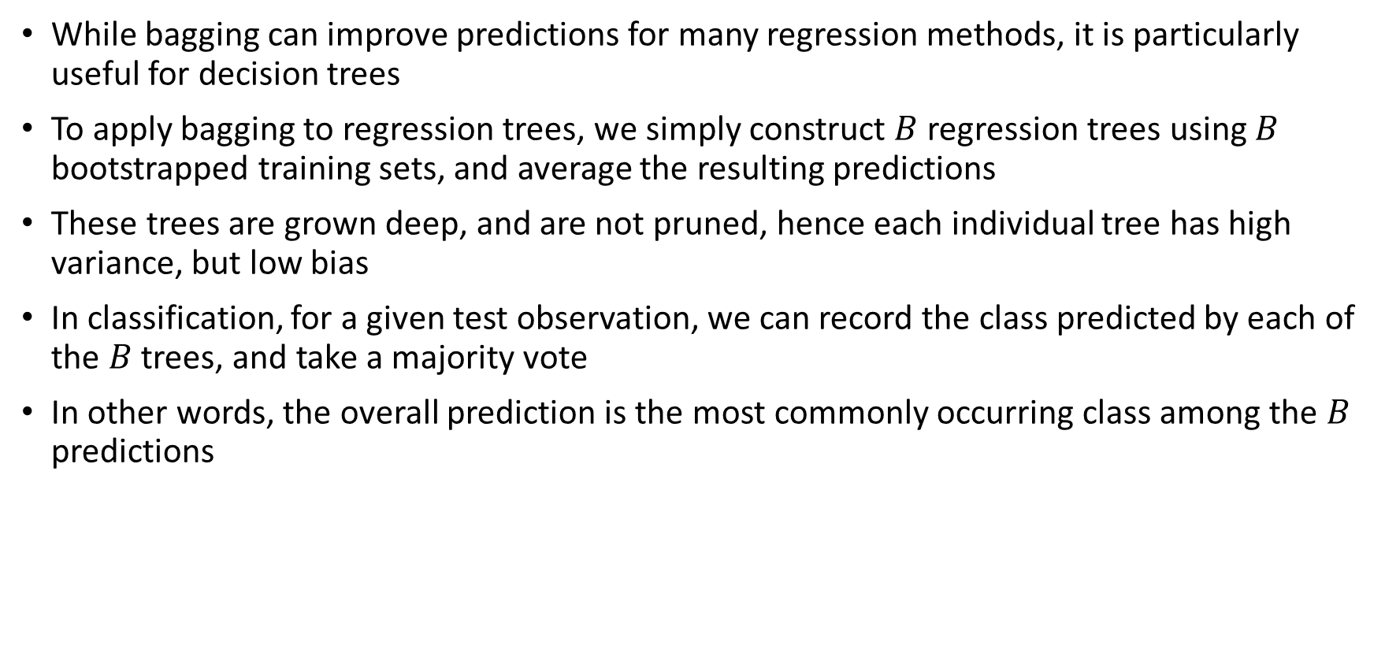
Bagging
While bagging can improve predictions for many regression methods, it is particularly useful for decision trees
To apply bagging to regression trees, we simply construct $B$ regression trees using $B$ bootstrapped training sets, and average the resulting predictions
These trees are grown deep, and are not pruned, hence each individual tree has high variance, but low bias
In classification, for a given test observation, we can record the class predicted by each of the $B$ trees, and take a majority vote
In other words, the overall prediction is the most commonly occurring class among the $B$ predictions

Slide 6
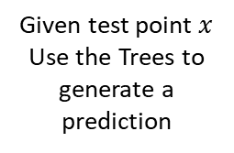

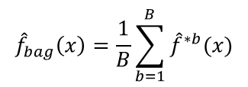


Bagging (Regression)
Bootstrapped Sample 1
Bootstrapped Sample 2
Bootstrapped Sample B
Tree 1
Tree 2
Tree B
.....
Given test point $x$
Use the Trees to generate a prediction
$${\hat{f}}^{∗1}(x)$$
$${\hat{f}}^{∗2}(x)$$
$${\hat{f}}^{∗B}(x)$$
Take the average to return the final prediciton
$${\hat{f}}_{bag}\left(x\right)=\frac{1}{B}\sum_{b=1}^{B}{{\hat{f}}^{∗b}(x)}$$

Slide 7


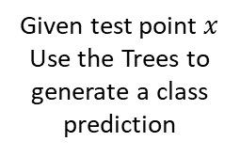
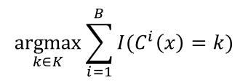

Bagging (Classification)
Bootstrapped Sample 1
Bootstrapped Sample 2
Bootstrapped Sample B
Tree 1
Tree 2
Tree B
.....
Given test point $x$
Use the Trees to generate a class prediction
$$C^{1}(x)$$
$$C^{2}(x)$$
$$C^{B}(x)$$
Take the majority vote among all predicted classes
$$\underset{k∈K}{argmax}{\sum_{i=1}^{B}{I(C^{i}\left(x\right)=k)}}$$

Slide 8
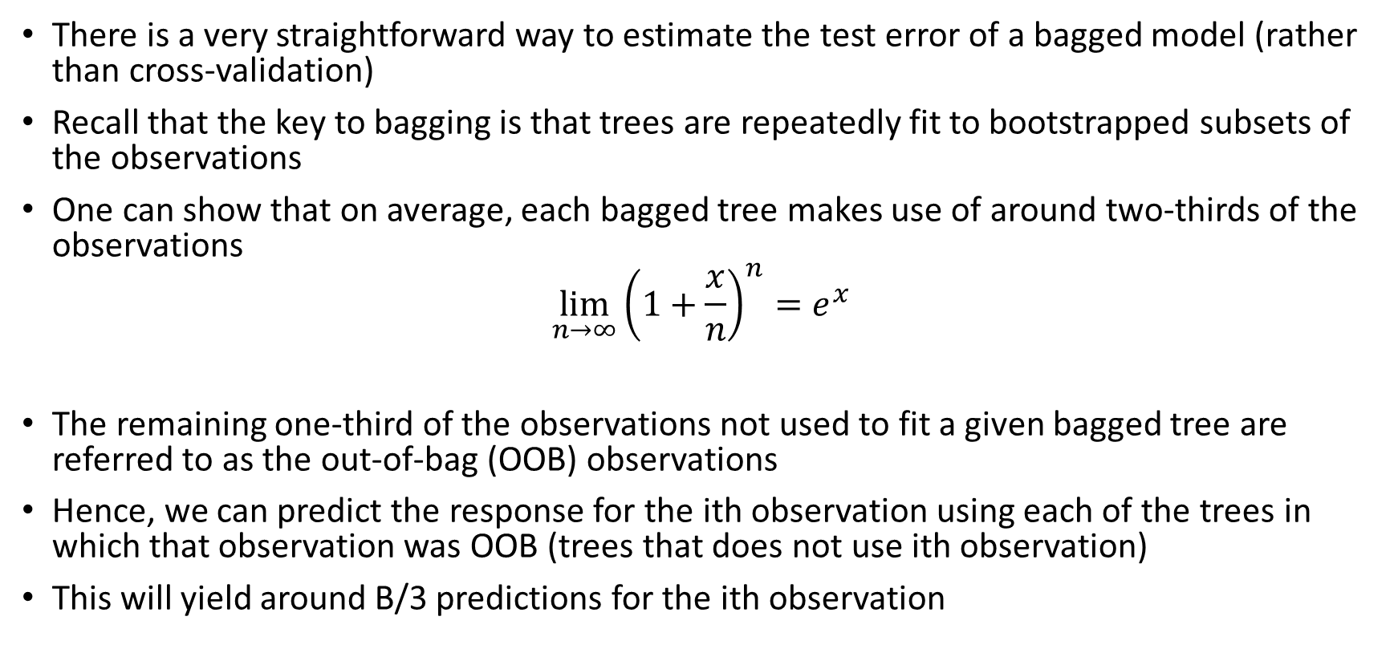
Out of Bag Error Estimation
There is a very straightforward way to estimate the test error of a bagged model (rather than cross-validation)
Recall that the key to bagging is that trees are repeatedly fit to bootstrapped subsets of the observations
One can show that on average, each bagged tree makes use of around two-thirds of the observations
$$\lim_{n→∞}{{\left(1+\frac{x}{n}\right)}^{n}}=e^{x}$$
The remaining one-third of the observations not used to fit a given bagged tree are referred to as the out-of-bag (OOB) observations
Hence, we can predict the response for the ith observation using each of the trees in which that observation was OOB (trees that does not use ith observation)
This will yield around B/3 predictions for the ith observation

Slide 9
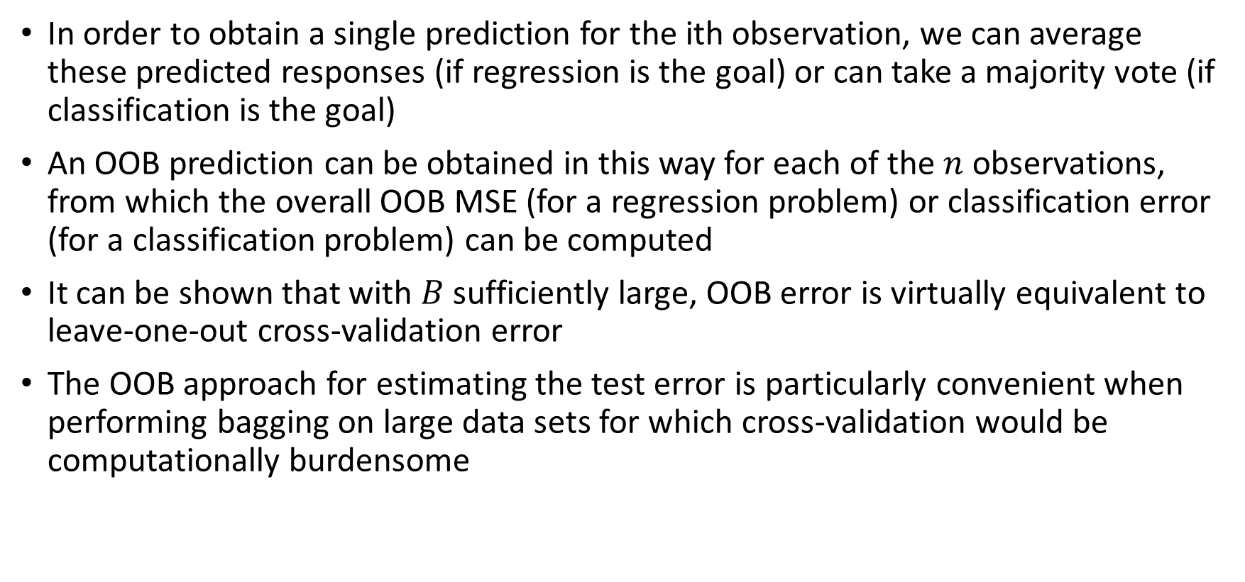
Out of Bag Error Estimation
In order to obtain a single prediction for the ith observation, we can average these predicted responses (if regression is the goal) or can take a majority vote (if classification is the goal)
An OOB prediction can be obtained in this way for each of the $n$ observations, from which the overall OOB MSE (for a regression problem) or classification error (for a classification problem) can be computed
It can be shown that with $B$ sufficiently large, OOB error is virtually equivalent to leave-one-out cross-validation error
The OOB approach for estimating the test error is particularly convenient when performing bagging on large data sets for which cross-validation would be computationally burdensome

Slide 10

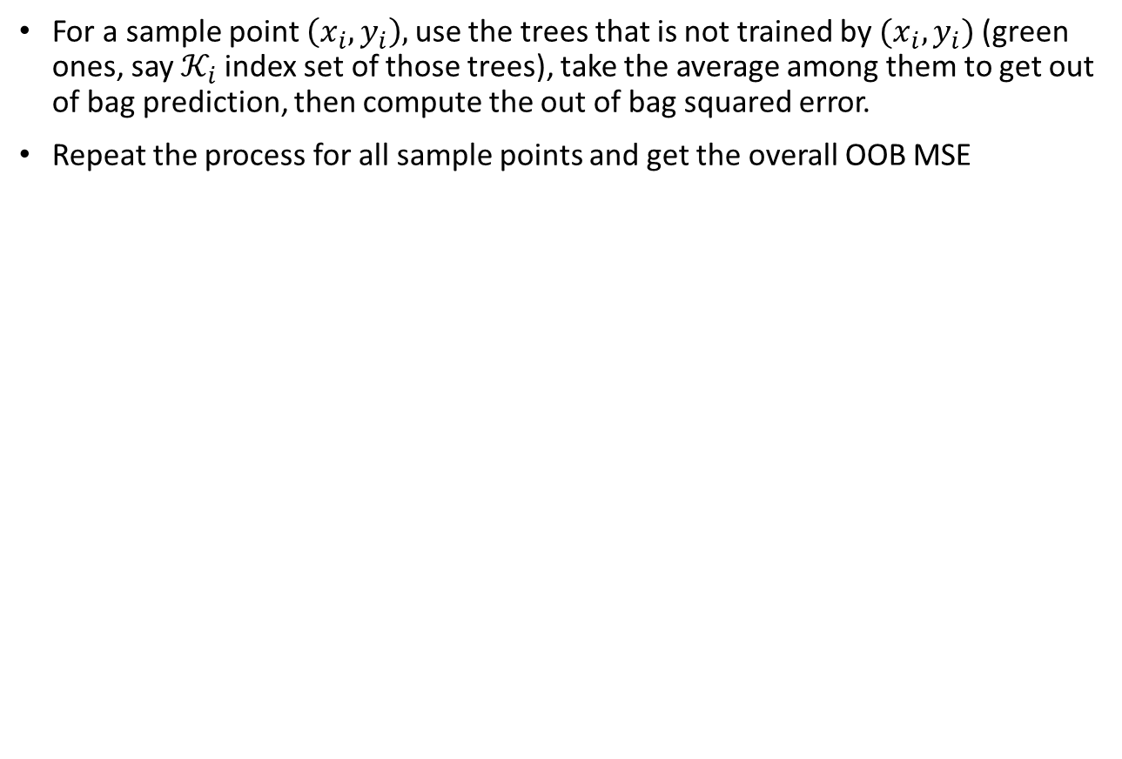
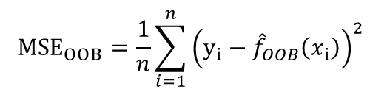
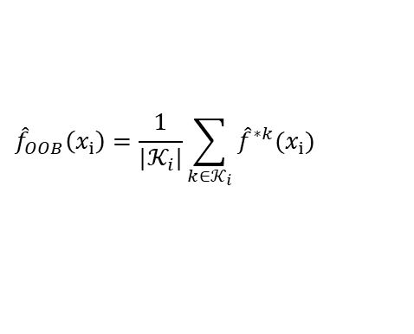

Out of Bag Error Estimation
For a sample point $\left(x_{i},y_{i}\right),$use the trees that is not trained by $(x_{i},y_{i})$ (green ones, say $𝒦_{i}$index set of those trees), take the average among them to get out of bag prediction, then compute the out of bag squared error.
Repeat the process for all sample points and get the overall OOB MSE
Bootstrap
Sample 1
Bootstrap
Sample 2
Bootstrap
Sample 3
Bootstrap
Sample j
Bootstrap
Sample B
Tree 1
Tree 2
Tree 3
.....
Tree j
.....
Tree B
$${\hat{f}}^{∗2}(x_{i})$$
$${\hat{f}}^{∗j}(x_{i})$$
$${\hat{f}}_{OOB}\left(x_{i}\right)=\frac{1}{|𝒦_{i}|}\sum_{k∈𝒦_{i}}{{\hat{f}}^{∗k}(x_{i}) }$$
$${MSE}_{OOB}=\frac{1}{n}\sum_{i=1}^{n}{{\left(y_{i}−{\hat{f}}_{OOB}\left(x_{i}\right)\right)}^{2}}$$

Slide 11
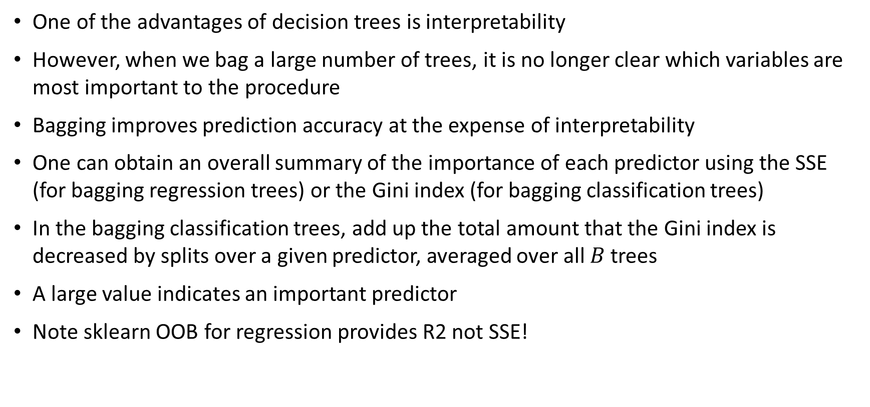
Bagging: Interpretability
One of the advantages of decision trees is interpretability
However, when we bag a large number of trees, it is no longer clear which variables are most important to the procedure
Bagging improves prediction accuracy at the expense of interpretability
One can obtain an overall summary of the importance of each predictor using the SSE (for bagging regression trees) or the Gini index (for bagging classification trees)
In the bagging classification trees, add up the total amount that the Gini index is decreased by splits over a given predictor, averaged over all $B$ trees
A large value indicates an important predictor
Note sklearn OOB for regression provides R2 not SSE!

Slide 12
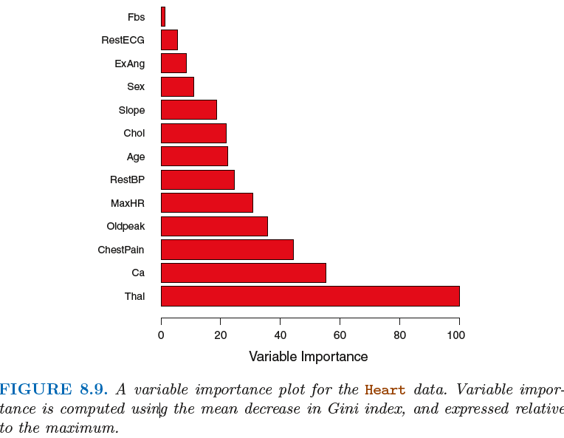
Bagging: Interpretability

Slide 13
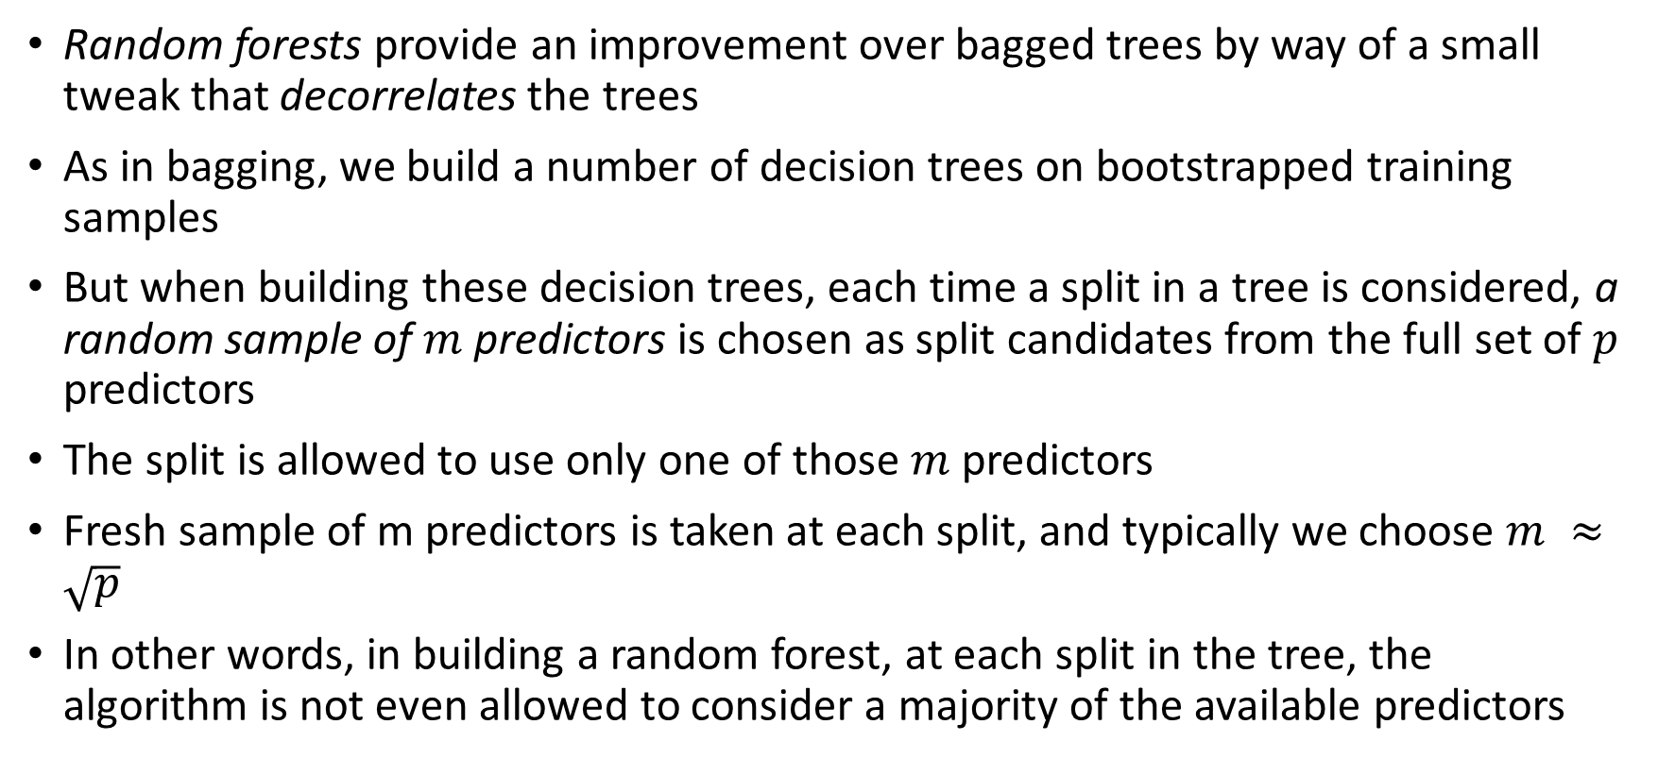
Random Forests
Random forests provide an improvement over bagged trees by way of a small tweak that decorrelates the trees
As in bagging, we build a number of decision trees on bootstrapped training samples
But when building these decision trees, each time a split in a tree is considered, a random sample of $m$ predictors is chosen as split candidates from the full set of $p$ predictors
The split is allowed to use only one of those $m$ predictors
Fresh sample of m predictors is taken at each split, and typically we choose $m ≈\sqrt{p}$
In other words, in building a random forest, at each split in the tree, the algorithm is not even allowed to consider a majority of the available predictors

Slide 14













Random Forests
Assume we have 9 features: $x_{1},x_{2},…,x_{9}$
Bootstrapped Sample 1
Bootstrapped Sample 2
Bootstrapped Sample B
Find best split among randomly selected three features
$$x_{2}<3$$
$$x_{4},x_{7},x_{9}$$
$$x_{4}<5$$
$$x_{1},x_{2},x_{8}$$
.....
$$x_{1},x_{6},x_{2}$$
$$x_{6}<3.5$$
$$x_{3}<2$$
$$x_{3},x_{4},x_{5}$$
$$x_{3},x_{7},x_{2}$$
$$x_{7}<1.5$$
$$x_{1},x_{9},x_{5}$$
$$x_{1}<10$$
.....
.....
.....
Tree 1
Tree 2
Tree B

Slide 15
Random Forests
This may sound crazy, but it has a clever rationale
Suppose that there is one very strong predictor in the data set, along with a number of other moderately strong predictors
Then in the collection of bagged trees, most or all of the trees will use this strong predictor in the top split
All of the bagged trees will look quite similar to each other
Hence the predictions from the bagged trees will be highly correlated
Unfortunately, averaging many highly correlated quantities does not lead to as large of a reduction in variance as averaging many uncorrelated quantities
Random forests overcome this problem by forcing each split to consider only a subset of the predictors

Slide 16
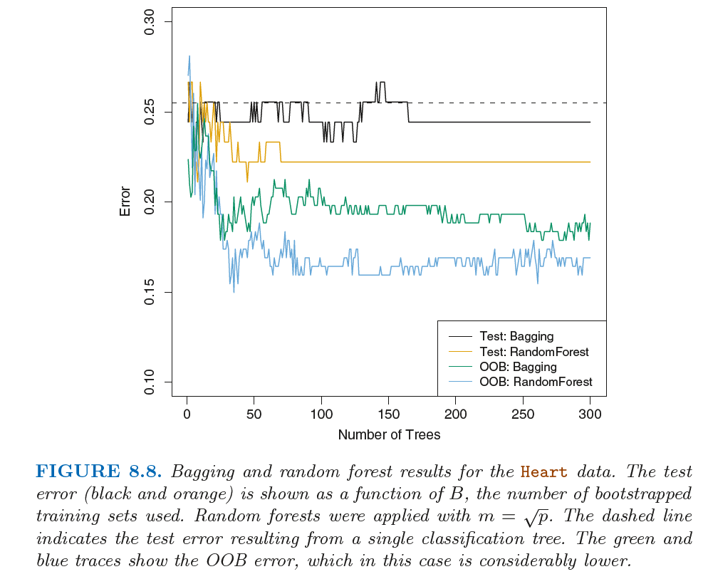
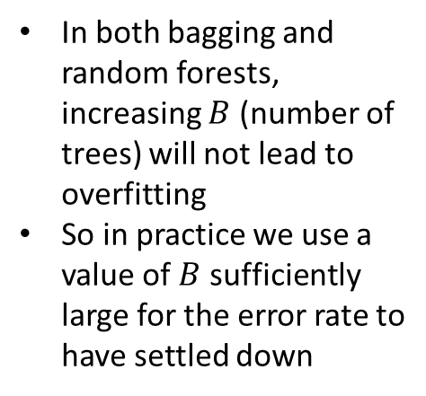
Random Forests
In both bagging and random forests, increasing $B$ (number of trees) will not lead to overfitting
So in practice we use a value of $B$ sufficiently large for the error rate to have settled down

Slide 17
Boosting
Like bagging, boosting is a general approach that can be applied to many statistical learning methods for regression or classification
Recall that bagging involves creating multiple copies of the original training data set using the bootstrap, fitting a separate decision tree to each copy, and then combining all of the trees in order to create a single predictive model
In boosting the trees are grown sequentially: each tree is grown using information from previously grown trees
Boosting does not involve bootstrap sampling; instead each tree is fit on a modified version of the original data set

Slide 18
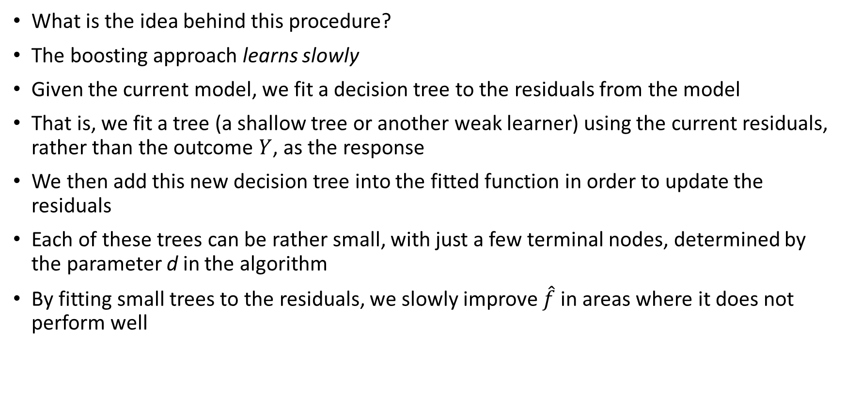
Boosting
What is the idea behind this procedure?
The boosting approach learns slowly
Given the current model, we fit a decision tree to the residuals from the model
That is, we fit a tree (a shallow tree or another weak learner) using the current residuals, rather than the outcome $Y$, as the response
We then add this new decision tree into the fitted function in order to update the residuals
Each of these trees can be rather small, with just a few terminal nodes, determined by the parameter d in the algorithm
By fitting small trees to the residuals, we slowly improve $\hat{f}$ in areas where it does not perform well

Slide 19
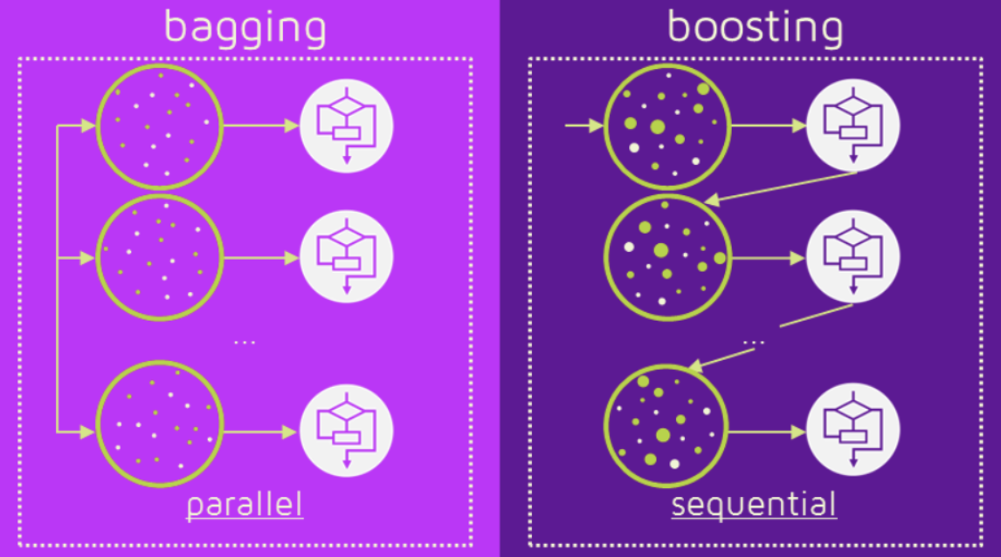
Boosting

Slide 20


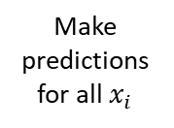
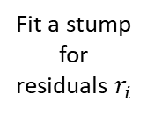


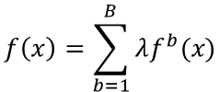

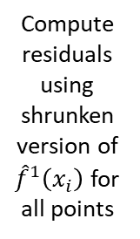
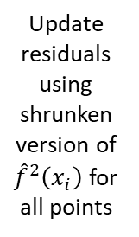


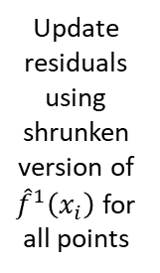
Boosting (gradient)
Fit a stump
(or some weak learner)
Fit a stump
for residuals $r_{i}$
Fit a stump
for residuals $r_{i}$
$$…$$
Make
predictions for all $x_{i}$
Make
predictions for all $x_{i}$
Make
predictions for all $x_{i}$
$$f\left(x\right)=\sum_{b=1}^{B}{λf^{b}(x)}$$
$${\hat{f}}^{1}\left(x_{i}\right)$$
$${\hat{f}}^{2}\left(x_{i}\right)$$
$${\hat{f}}^{B}\left(x_{i}\right)$$
Compute residuals using shrunken version of ${\hat{f}}^{1}\left(x_{i}\right)$ for all points
Update residuals using shrunken version of ${\hat{f}}^{2}\left(x_{i}\right)$ for all points
Update residuals using shrunken version of ${\hat{f}}^{1}\left(x_{i}\right)$ for all points
$$r_{i}=y_{i}−λ{\hat{f}}^{1}\left(x_{i}\right)$$
$$r_{i}=r_{i}−λ{\hat{f}}^{2}\left(x_{i}\right)$$
$$r_{i}=r_{i}−λ{\hat{f}}^{B}\left(x_{i}\right)$$

Slide 21
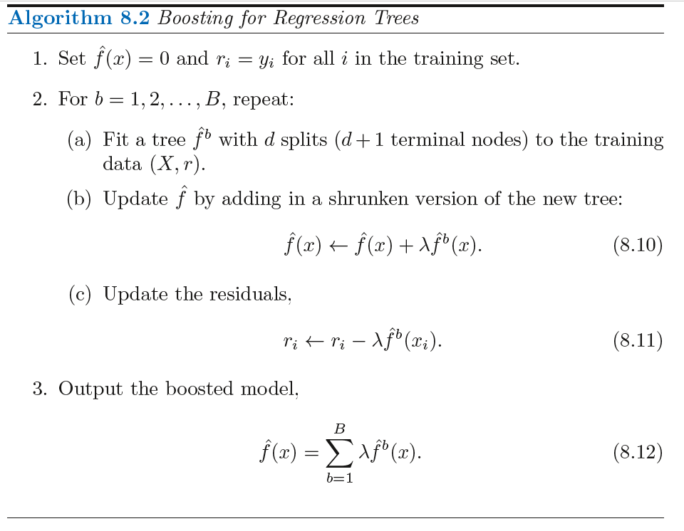
Boosting (gradient)

Slide 22
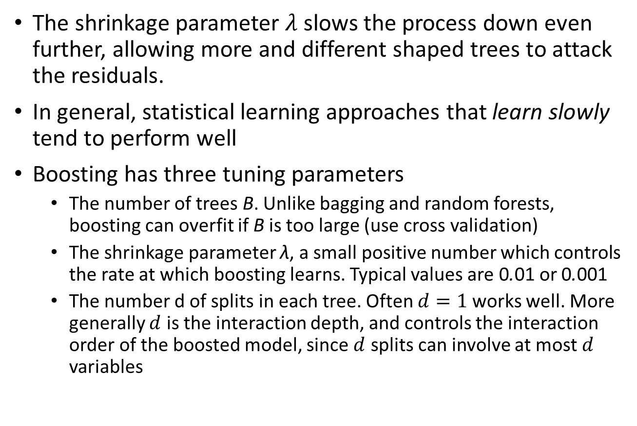
Boosting
The shrinkage parameter $λ$ slows the process down even further, allowing more and different shaped trees to attack the residuals.
In general, statistical learning approaches that learn slowly tend to perform well
Boosting has three tuning parameters
The number of trees B. Unlike bagging and random forests, boosting can overfit if B is too large (use cross validation)
The shrinkage parameter λ, a small positive number which controls the rate at which boosting learns. Typical values are 0.01 or 0.001
The number d of splits in each tree. Often $d=1$works well. More generally $d$ is the interaction depth, and controls the interaction order of the boosted model, since $d$ splits can involve at most $d$ variables

Slide 23
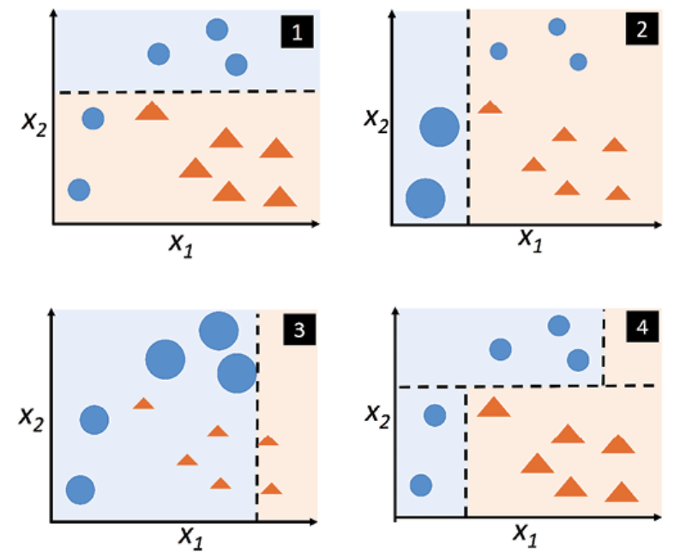
Boosting (Adaptive)
Consider a two-class problem, with the output variable coded as Y ∈ {−1, 1}
The adaptive boosting also applies weak learners to data.
Initially all data points have equal weights but as we keep fitting weak learners, the weights of the points that are misclassified will increase and the ones that correctly classified will decrease.
So the next learner will focus on the misclassified ones

Slide 24
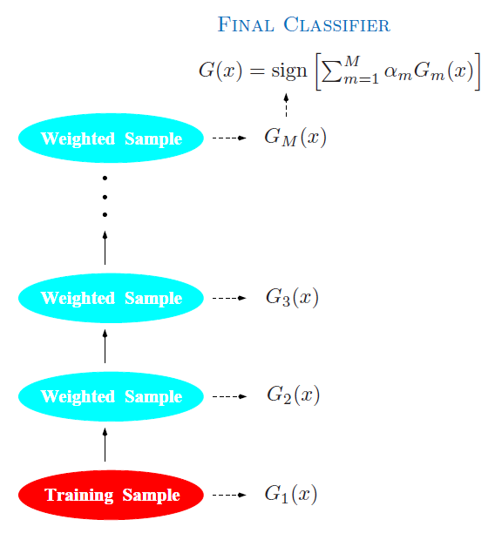
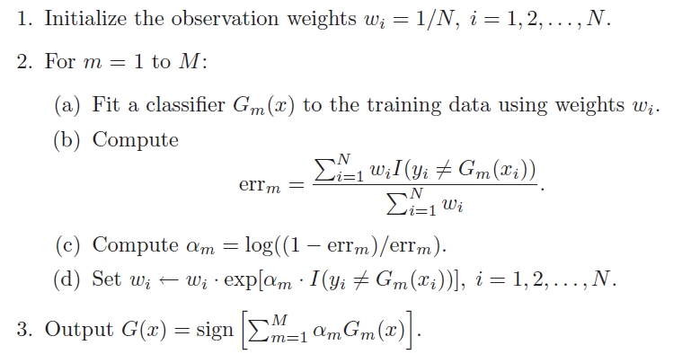
Boosting (Adaptive)

